Slide 1
Identity, Access, and Security

Slide 2
Identity, Access, and Security - Objective Domain
Describe the benefits and usage of:
Describe directory services in Azure, including Microsoft Entra ID and Microsoft Entra Domain Services.
Describe authentication methods in Azure, including single sign-on (SSO), multifactor authentication (MFA), and password-less.
Describe external identities and guest access in Azure.
Describe Microsoft Entra Conditional Access.
Describe Azure Role Based Access Control (RBAC).
Describe the concept of Zero Trust.
Describe the purpose of the defense in depth model.
Describe the purpose of Microsoft Defender for Cloud.
Notes:
https://docs.microsoft.com/learn/modules/describe-azure-identity-access-security/1-introduction

Slide 3
Active Directory Domain Services (AD DS)
AD DS and its related services form the foundation for enterprise networks that run Windows operating systems.
The AD DS database is the central store of all the domain objects, such as user accounts, computer accounts, and groups.
AD DS provides a searchable, hierarchical directory and a method for applying configuration and security settings for objects in an enterprise.
In addition, you can use AD DS options to perform actions such as:
Installing, configuring, and updating apps.
Managing the security infrastructure.
Enabling Remote Access Service and DirectAccess.
Issuing and managing digital certificates.
Notes:
Define AD DS - Training | Microsoft Learn

Slide 4
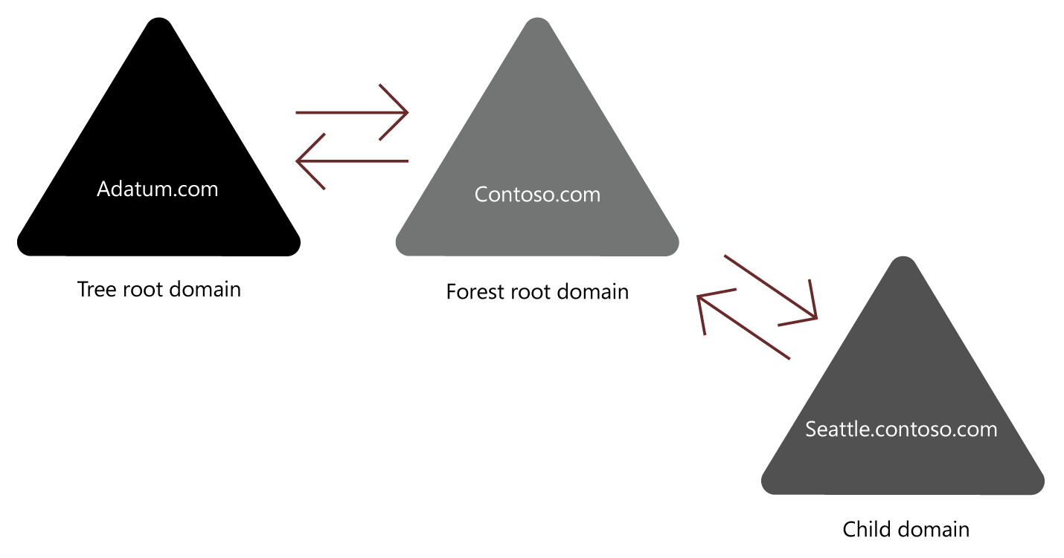
What is an AD DS forest?
A Forest is a top-level container in AD DS
AD DS forest often described as:
Security boundary
A replication boundary
Trust relationships
Provide access to resources in a complex AD DS environment
Notes:
Learn - https://docs.microsoft.com/en-us/learn/modules/introduction-to-ad-ds/4-define-forests-domains
An AD DS forest is a collection of one or more AD DS trees that contain one or more AD DS domains. Domains in a forest share:
A common root.
A common schema.
A global catalog.
An AD DS domain is a logical administrative container for objects such as:
Users
Groups
Computers
The following objects exist in the forest root domain:
The schema master role.
The domain naming master role.
The Enterprise Admins group.
The Schema Admins group.
The following objects exist in each domain (including the forest root):
The RID master role.
The Infrastructure master role.
The PDC emulator master role.
The Domain Admins group.

Slide 5
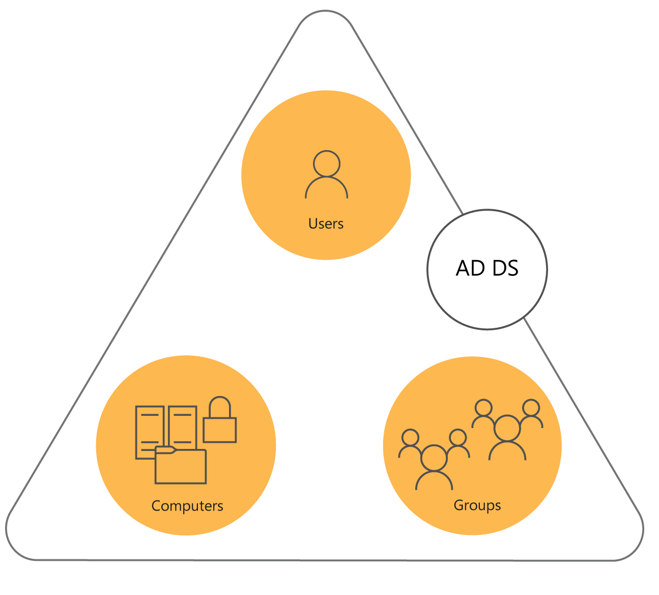
What is an AD DS domain?
AD DS domain is logical container for managing user, computer, group, and other objects
AD DS domain is often described as:
A replication boundary
An administrative unit
An AD DS domain provides:
Authentication
Authorization
Notes:
Learn - https://docs.microsoft.com/en-us/learn/modules/introduction-to-ad-ds/4-define-forests-domains
Explain the relationships among the forest root domain, a child domain, and another tree. Emphasize that there is no administrative difference between the child domain and the other tree, apart from the names.
Suggest you use the whiteboard to record a typical multidomain, or even a multiforest, AD DS environment. Identify the types of trusts on your diagram.
Types of trust
Parent and child
Tree-root
External
Realm
Forest
Shortcut

Slide 6
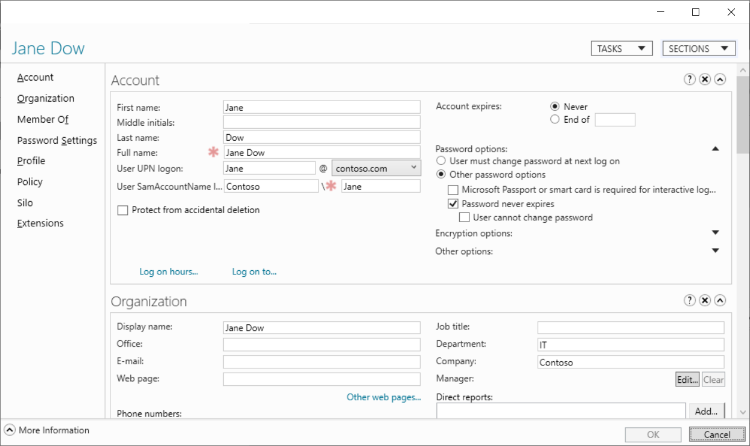
Define user objects
Create user objects
A user account includes:
The username
A user password
Group memberships
Notes:
Learn - https://docs.microsoft.com/en-us/learn/modules/introduction-to-ad-ds/3-define-users-groups-computers
Consider demonstrating these object types (and those described in the next few slides) as you discuss them.

Slide 7
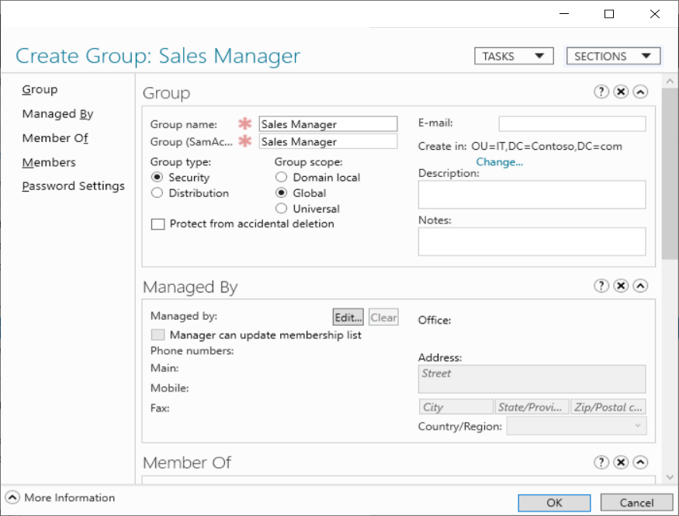
Define group objects
What are group objects?
Group types
Security
Distribution
Group scopes
Local
Domain-local
Global
Universal
Notes:
Learn - https://docs.microsoft.com/en-us/learn/modules/introduction-to-ad-ds/3-define-users-groups-computers

Slide 8
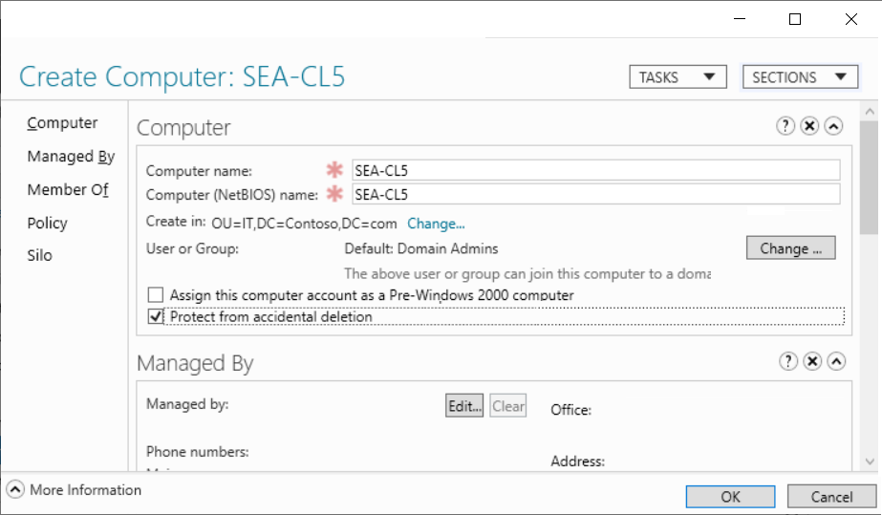
Define computer objects
Computers are security principals:
They have an account with a sign-in name and password.
They authenticate with the domain.
They can belong to groups and have access to resources
Notes:
Learn - https://docs.microsoft.com/en-us/learn/modules/introduction-to-ad-ds/3-define-users-groups-computers
What are computer objects?
Computers, like users, are security principals, in that:
They have an account with a sign-in name and password that Windows changes automatically on a periodic basis.
They authenticate with the domain.
They can belong to groups and have access to resources, and you can configure them by using Group Policy.
A computer account begins its lifecycle when you create the computer object and join it to your domain. After you join the computer account to your domain, day-to-day administrative tasks include:
Configuring computer properties.
Moving the computer between OUs.
Managing the computer itself.
Renaming, resetting, disabling, enabling, and eventually deleting the computer object.
Computers container
Before you create a computer object in AD DS, you must have a place to put it. The Computers container is a built-in container in an AD DS domain. This container is the default location for the computer accounts when a computer joins the domain.
This container is not an OU. Instead, it is an object of the Container class. Its common name is CN=Computers. There are subtle but important differences between a container and an OU. You cannot create an OU within a container, so you cannot subdivide the Computers container. You also cannot link a Group Policy Object to a container. Therefore, we recommend that you create custom OUs to host computer objects, instead of using the Computers container.

Slide 9

Azure Entra ID

Slide 10
Azure Entra ID
Microsoft Entra ID is a directory service that enables you to sign in and access both Microsoft cloud applications and cloud applications that you develop.
For on-premises environments, Active Directory running on Windows Server provides an identity and access management service that's managed by your organization.
Microsoft Entra ID is Microsoft's cloud-based identity and access management service. With Microsoft Entra ID, you control the identity accounts, but Microsoft ensures that the service is available globally.
Notes:
https://docs.microsoft.com/learn/modules/describe-azure-identity-access-security/2-directory-services

Slide 11
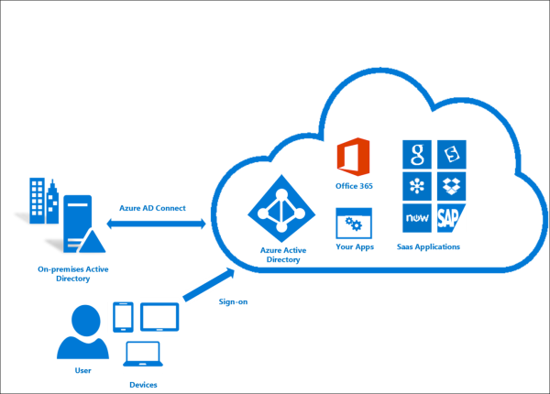
Entra ID Connect
Azure AD Connect provides the following features:
Password Hash Sync
Users & Groups Synch
Users can use a single identity to access on-premises applications and cloud services such as Microsoft 365.
Notes:
https://learn.microsoft.com/en-us/entra/identity/hybrid/connect/whatis-azure-ad-connect

Slide 12
Entra ID Usage
Microsoft Entra ID is for:
IT administrators. Administrators can use Microsoft Entra ID to control access to applications and resources based on their business requirements.
App developers. Developers can use Microsoft Entra ID to provide a standards-based approach for adding functionality to applications that they build, such as adding SSO functionality to an app or enabling an app to work with a user's existing credentials.
Users. Users can manage their identities and take maintenance actions like self-service password reset.
Online service subscribers. Microsoft 365, Microsoft Office 365, Azure, and Microsoft Dynamics CRM Online subscribers are already using Microsoft Entra ID to authenticate into their account.

Slide 13
Azure Entra ID
Microsoft Entra ID is a cloud-based identity and access management service that an organization’s employees can use to access internal and external resources. It provides services such as:
Authentication: Verifying identity to access applications and resources. It also includes providing functionality such as self-service password reset, multifactor authentication, a custom list of banned passwords, and smart lockout services.
Single sign-on (SSO): Single sign-on (SSO) enables you to remember only one username and one password to access multiple applications.
Application management: You can manage your cloud and on-premises apps by using Microsoft Entra ID. Features like Application Proxy, SaaS apps, the My Apps portal, and single sign-on provide a better user experience.
Device management: Microsoft Entra ID supports the registration of devices, which enables devices to be managed through tools like Microsoft Intune. It also allows for device-based Conditional Access policies to restrict access attempts to only those coming from known devices, regardless of the requesting user account.
Notes:
https://docs.microsoft.com/learn/modules/describe-azure-identity-access-security/2-directory-services
https://learn.microsoft.com/en-us/entra/fundamentals/whatis

Slide 14
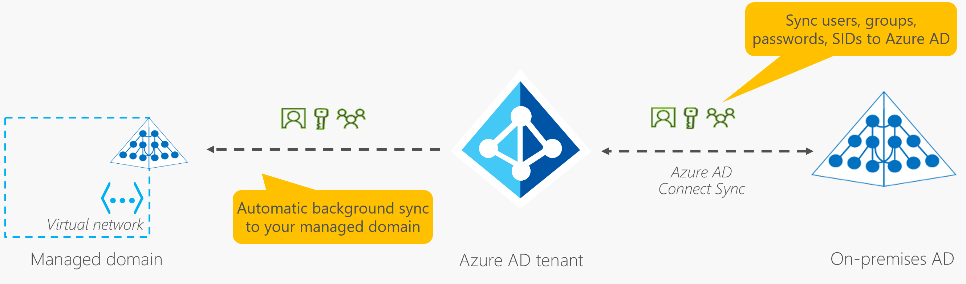
Entra Domain Services
Gain the benefit of cloud-based domain services without managing domain controllers
Run legacy applications (that can’t use modern auth standards) in the cloud
Automatically sync from Azure AD
Notes:
https://docs.microsoft.com/learn/modules/describe-azure-identity-access-security/2-directory-services
https://learn.microsoft.com/en-us/entra/identity/domain-services/overview

Slide 15
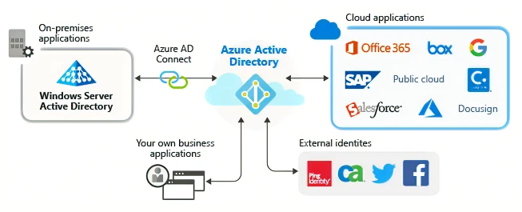

Slide 16



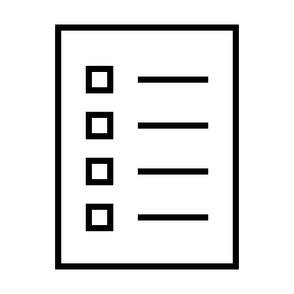





Compare Authentication and Authorization
Authentication
Identifies the person or service seeking access to a resource.
Requests legitimate access credentials.
Basis for creating secure identity and access control principles.
Authorization
Determines an authenticated person’s or service’s level of access.
Defines which data they can access, and what they can do with it.
Notes:
https://docs.microsoft.com/learn/modules/describe-azure-identity-access-security/3-authentication-methods
✔️Authentication is sometimes shortened to AuthN, and authorization is sometimes shortened to AuthZ.
Authentication
Identifies the person or service seeking access to a resource.
Requests legitimate access credentials.
Basis for creating secure identity and access control principles.
Authorization
Determines an authenticated person’s or service’s level of access.
Defines which data they can access, and what they can do with it.

Slide 17
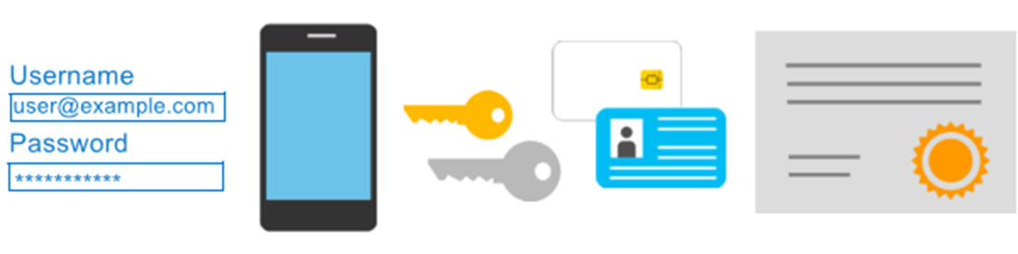
Azure Multi-Factor Authentication
Provides additional security for your identities by requiring two or more elements for full authentication.
Something you know ←→ Something you possess ←→ Something you are
Notes:
https://docs.microsoft.com/learn/modules/describe-azure-identity-access-security/3-authentication-methods
Discuss what could qualify for each of the items listed
Something you know: This could be a password or the answer to a security question.
Something you possess: This might be a mobile app that receives a notification, or a token-generating device.
Something you are: This is typically some sort of biometric property, such as a fingerprint or face scan used on many mobile devices.
MFA - https://docs.microsoft.com/en-us/azure/active-directory/authentication/concept-mfa-howitworks

Slide 18
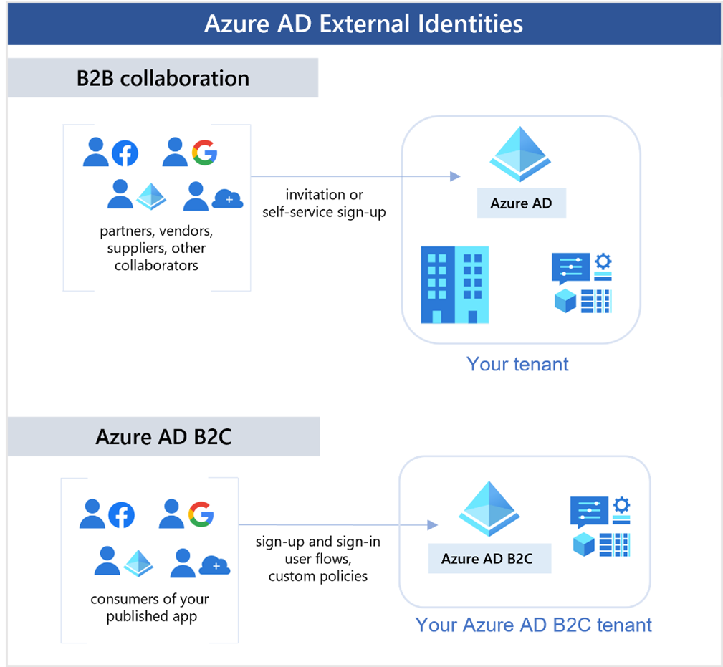
External Identities B2B
Notes:
https://learn.microsoft.com/en-us/training/modules/describe-azure-identity-access-security/4-external-identities
Business to business (B2B) collaboration - Collaborate with external users by letting them use their preferred identity to sign-in to your Microsoft applications or other enterprise applications (SaaS apps, custom-developed apps, etc.). B2B collaboration users are represented in your directory, typically as guest users.

Slide 19
External Identities B2C
Notes:
https://docs.microsoft.com/learn/modules/describe-azure-identity-access-security/4-external-identities

Slide 20
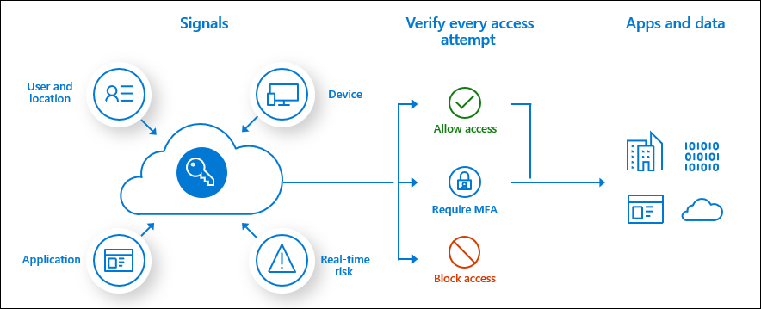
Conditional Access
Conditional Access is a tool that Microsoft Entra ID uses to allow (or deny) access to resources based on identity signals.
These signals include who the user is, where the user is, and what device the user is requesting access from.
User or Group Membership
IP Location
Device
Application
Risk Detection
Notes:
https://learn.microsoft.com/en-us/training/modules/describe-azure-identity-access-security/5-conditional-access
https://docs.microsoft.com/en-us/azure/active-directory/conditional-access/overview
The modern security perimeter now extends beyond an organization's network to include user and device identity. Organizations can utilize these identity signals as part of their access control decisions.
Conditional Access is the tool used by Azure Active Directory to bring signals together, to make decisions, and enforce organizational policies. Conditional Access is at the heart of the new identity driven control plane.
Conditional Access policies at their simplest are if-then statements, if a user wants to access a resource, then they must complete an action. Example: A payroll manager wants to access the payroll application and is required to perform multi-factor authentication to access it.
Administrators are faced with two primary goals:
Empower users to be productive wherever and whenever
Protect the organization's assets
By using Conditional Access policies, you can apply the right access controls when needed to keep your organization secure and stay out of your user's way when not needed.

Slide 21
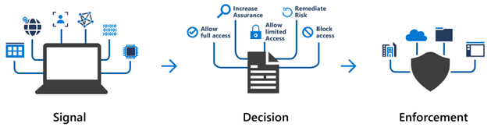
Conditional Access
Here, the signal might be the user's location, the user's device, or the application that the user is trying to access.
Based on these signals, the decision might be to allow full access if the user is signing in from their usual location. If the user is signing in from an unusual location or a location that's marked as high risk, then access might be blocked entirely or possibly granted after the user provides a second form of authentication.
Enforcement is the action that carries out the decision. For example, the action is to allow access or require the user to provide a second form of authentication.

Slide 22
When can I use Conditional Access?
Conditional Access is useful when you need to:
Require multifactor authentication (MFA) to access an application depending on the requester’s role, location, or network. For example, you could require MFA for administrators but not regular users or for people connecting from outside your corporate network.
Require access to services only through approved client applications. For example, you could limit which email applications are able to connect to your email service.
Require users to access your application only from managed devices. A managed device is a device that meets your standards for security and compliance.
Block access from untrusted sources, such as access from unknown or unexpected locations.

Slide 23





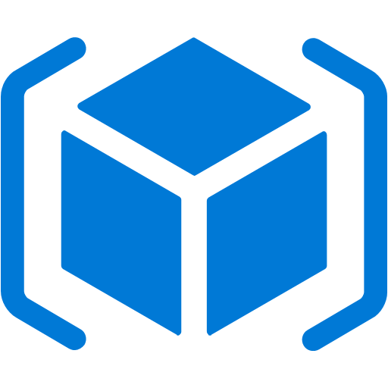
Azure role-based access control (Azure RBAC)
Fine-grained access management.
Segregate duties within the team and grant only the amount of access to users that they need to perform their jobs.
Enables access to the Azure portal and controlling access to resources.
Azure
Active Directory
Azure
subscription
User
Apps
User groups
Resource group
Resource group
Notes:
https://docs.microsoft.com/learn/modules/describe-azure-identity-access-security/6-role-based-access-control
Azure RBAC - https://docs.microsoft.com/en-us/azure/role-based-access-control/overview

Slide 24
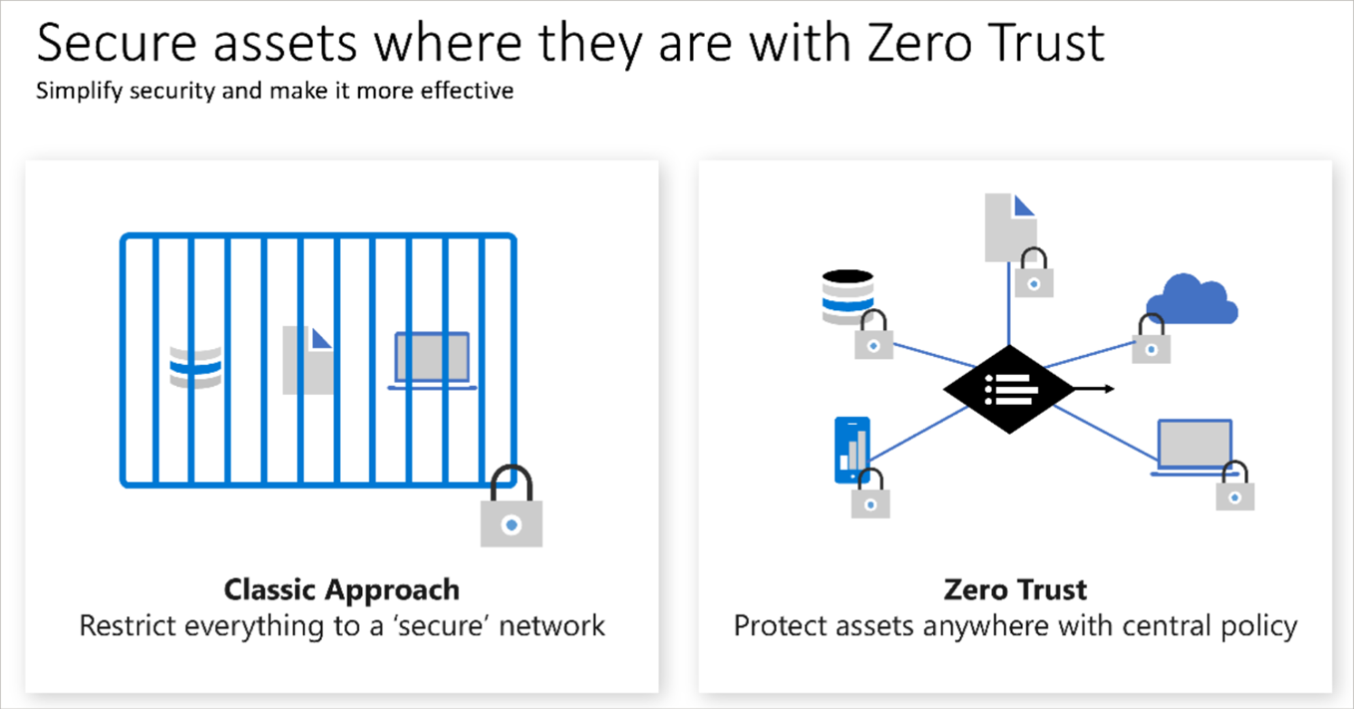
Zero Trust
Notes:
https://docs.microsoft.com/learn/modules/describe-azure-identity-access-security/7-describe-zero-trust-model

Slide 25
Defense in depth
Physical Security
A layered approach to securing computer systems.
Provides multiple levels of protection.
Attacks against one layer are isolated from subsequent layers.
Identity & Access
Perimeter
Network
Compute
Application
Data
Notes:
https://docs.microsoft.com/learn/modules/describe-azure-identity-access-security/8-describe-defense-depth
Here's a brief overview of the role of each layer:
The physical security layer is the first line of defense to protect computing hardware in the datacenter.
The identity and access layer controls access to infrastructure and change control.
The perimeter layer uses distributed denial of service (DDoS) protection to filter large-scale attacks before they can cause a denial of service for users.
The network layer limits communication between resources through segmentation and access controls.
The compute layer secures access to virtual machines.
The application layer helps ensure that applications are secure and free of security vulnerabilities.
The data layer controls access to business and customer data that you need to protect.

Slide 26
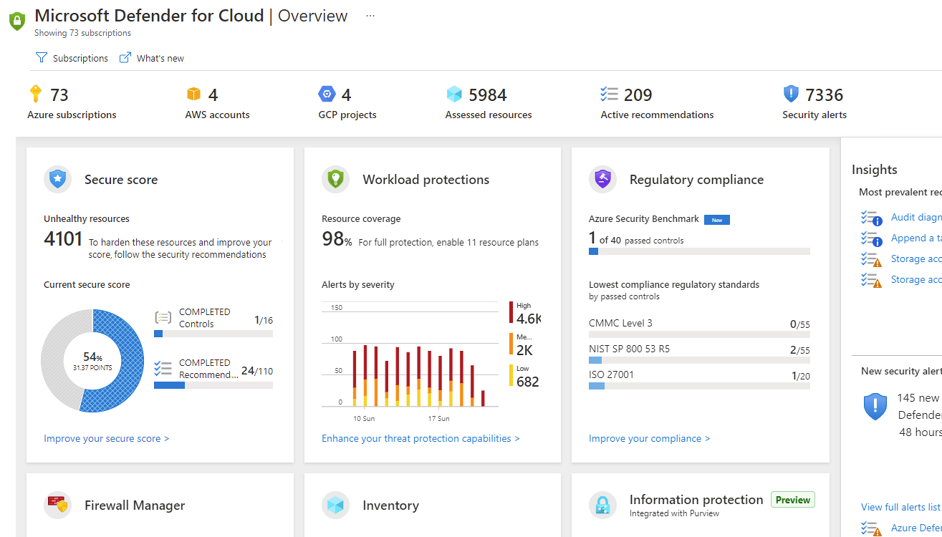
Microsoft Defender for Cloud
Defender for Cloud is a monitoring tool for security posture management and threat protection. It monitors your cloud, on-premises, hybrid, and multicloud environments to provide guidance and notifications aimed at strengthening your security posture.
Provides security recommendations
Detect and block malware
Analyze and identify potential attacks
Just-in-time access control for ports
Notes:
https://docs.microsoft.com/learn/modules/describe-azure-identity-access-security/9-describe-microsoft-defender-for-cloud
Microsoft Defender for Cloud is a unified infrastructure security management system that strengthens the security posture of your data centers and provides advanced threat protection across your hybrid workloads in the cloud - whether they're in Azure or not - as well as on premises.
Strengthen security posture: Defender for Cloud assesses your environment and enables you to understand the status of your resources, and whether they are secure.
Protect against threats: Defender for Cloud assesses your workloads and raises threat prevention recommendations and security alerts.
Get secure faster: In Defender for Cloud, everything is done in cloud speed. Because it is natively integrated, deployment is easy, providing you with auto-provisioning and protection with Azure services.
Policy compliance Defender for Cloud is built on top of Azure Policy controls so you can set and monitor your policies to run on management groups, across subscriptions, and even for a whole tenant.
Security alerts Defender for Cloud automatically collects, analyzes, and integrates log data from your Azure resources like firewall and endpoint protection to detect real threats. Then list of prioritized security alerts is shown in Microsoft Defender for Cloud along with the information you need to quickly investigate and remediate an attack.
Secure score Defender for Cloud continually assesses your resources for security issues; then aggregates all the findings into a single score so that you can tell your current security situation.
Microsoft Defender for Cloud - https://azure.microsoft.com/services/defender-for-cloud/

Slide 27
Defender for Cloud
Defender for Cloud helps you detect threats across:
Azure PaaS services – Detect threats targeting Azure services including Azure App Service, Azure SQL, Azure Storage Account, and more data services. You can also perform anomaly detection on your Azure activity logs using the native integration with Microsoft Defender for Cloud Apps (formerly known as Microsoft Cloud App Security).
Azure data services – Defender for Cloud includes capabilities that help you automatically classify your data in Azure SQL. You can also get assessments for potential vulnerabilities across Azure SQL and Storage services, and recommendations for how to mitigate them.
Networks – Defender for Cloud helps you limit exposure to brute force attacks. By reducing access to virtual machine ports, using the just-in-time VM access, you can harden your network by preventing unnecessary access. You can set secure access policies on selected ports, for only authorized users, allowed source IP address ranges or IP addresses, and for a limited amount of time.

